Slide 1
Cloud Storage

Slide 2
Content
Introduction
What is cloud storage?
How does cloud storage works?
Advantages of cloud storage
Conclusion

Slide 3
Introduction
Cloud storage is a model of data storage in which the digital data is stored in logical pools, the physical storage spans multiple servers (and often locations), and the physical environment is typically owned and managed by a hosting company.

Slide 4
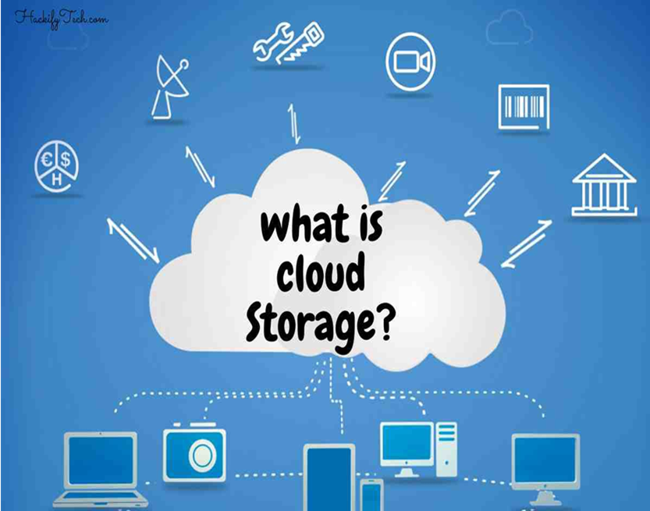
What is cloud storage?
History
J.C.R. Licklider – One of the fathers of the cloud based computing idea.
Global network that allows access from anywhere at anytime.
Concept
Cloud storage is a service model in which data is maintained , managed and backed up remotely and made available to users over a network (typically the Internet).

Slide 5
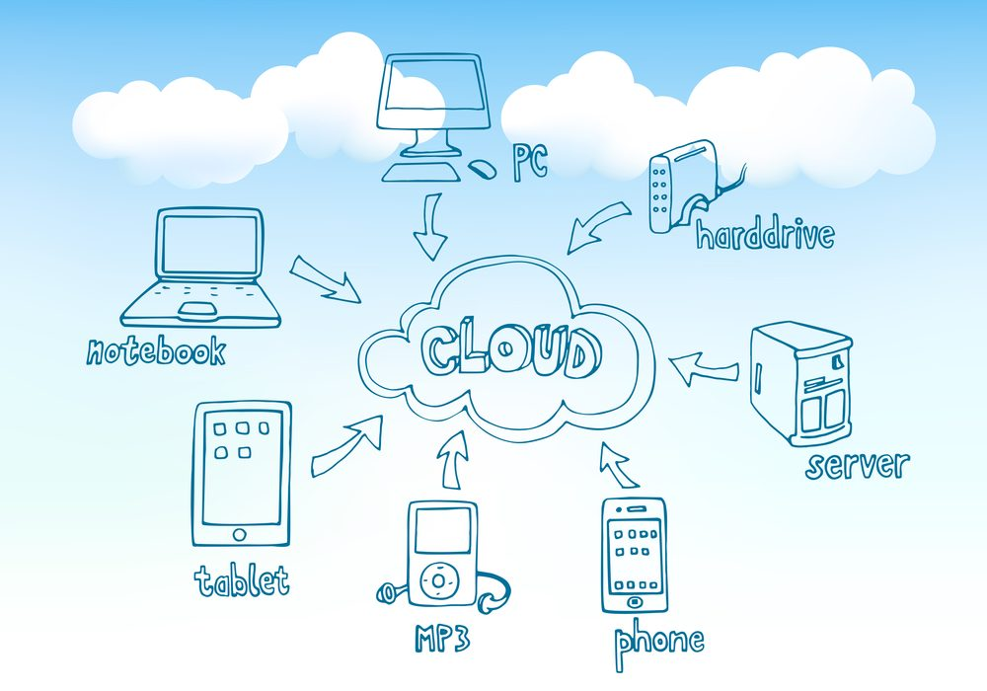
How does cloud storage works?
Redundancy
Core of cloud computing
Equipment
Data servers
Power suppliers
Data files
Replications

Slide 6
Advantages of cloud storage
Usability
Bandwidth
Accessibility
Disaster Recovery
Cost Savings

Slide 7
conclusion
Grid Computing was the last research-led centralized approach.
However there are concerns that the mainstream adoption of cloud computing cause many problems for users.
Many new open source systems apprearing that you can install and run on your local cluster.

Slide 8
thanks

